Slide 1
Welcome to Atherstone Nursery School and Warwickshire Early Years Hub
“This is an Outstanding School. Children are happy to come to school because they are excited by their learning and because they have excellent relationships with the adults they work with.”
Ofsted January 2019

Slide 2
Welcome!

Slide 3
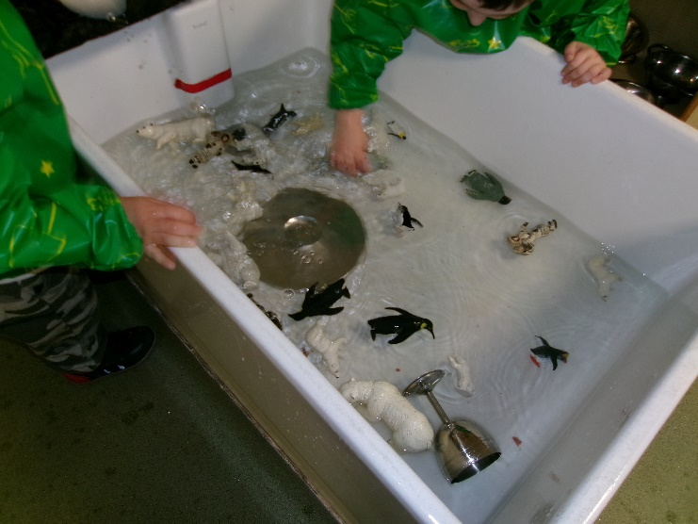
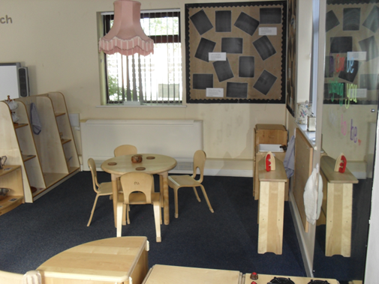
OFSTED Report January 2019 “The leadership team has maintained the outstanding quality of education in the school since the last (outstanding) inspection. Children acquire skills and knowledge through learning opportunities that are imaginative and fun. Adults also ensure that important reading, writing and mathematical knowledge and skills are woven into all aspects of learning. No opportunities are missed to practise counting or to recognise familiar letters and the sounds they make. You and your team are determined that all children will be as well prepared as they can be for the next stage in their education. .

Slide 4
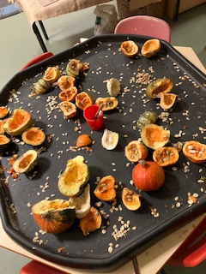
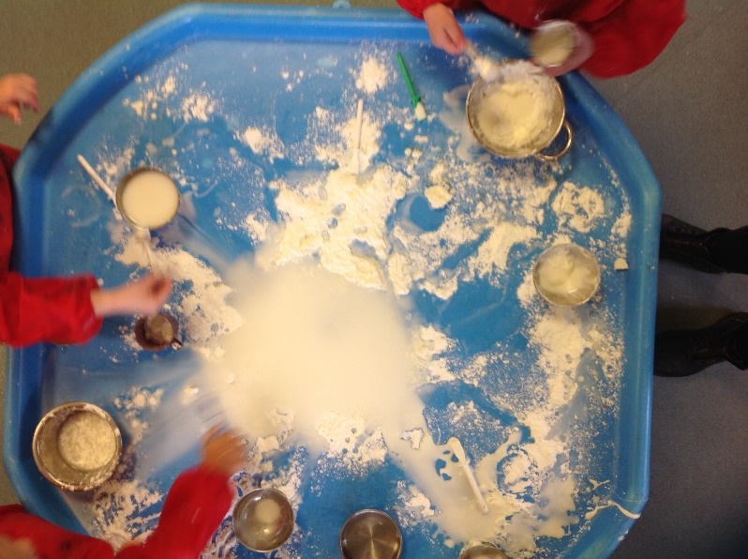
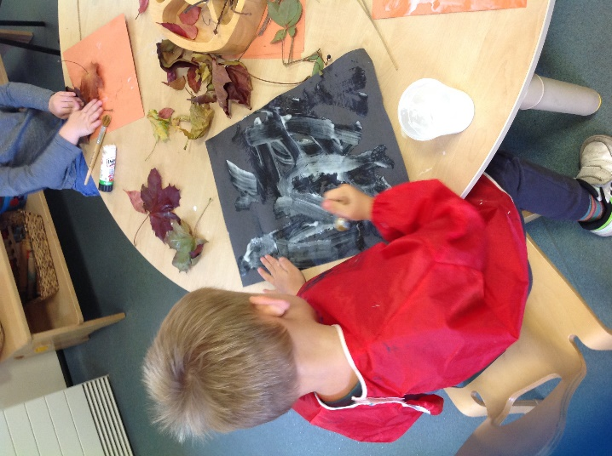
Our aim is to: ‘Provide a rich and stimulating environment which enables the unique child to become a happy, confident and independent learner.’

Slide 5
Home/School Partnership
As a school we want to work in partnership with you to ensure that your child’s time at nursery is happy and productive. We ask that you match that commitment through
Ensuring regular attendance, but not sending children to school when they are unwell.
Supporting the approach of the school and our golden rules for behaviour.
Supporting your child with learning opportunities at home and taking an active interest in their learning at nursery.
Keeping us well informed about any changes, problems or concerns that may affect a child's behaviour or learning.

Slide 6
Staff
Come and Meet the staff at Atherstone
Senior Leadership Team
Mrs Nicci Burton Executive Head of Federation/SENCO (Monday, Tuesday and every other Wednesday) DSL
Mrs Karen Barratt Business, HR & Finance Manager (Monday, Friday and every other Thursday)
Mrs Grace Shergold Head of School (Monday, Thursday and Friday) DSL
Mrs Sharon Wood Federation SENCO (Monday, Wednesday) DSL
Mrs Barbara Charles Safeguarding Lead, Pastoral & Family Support Manager (Tuesday and Friday) DSL
Mrs Carole Jackson Head of School at Bedworth Heath Nursery School (Mon-Wed) DSL
Nursery staff Mrs Mel Hillyer Nursery Lead Teacher (Monday – Wednesday)
Mrs Jo Charles Nursery Lead Teacher (Thursday and Friday)
Miss Sue Carthy Senior Early Years Educator Butterfly Nursery (Monday, Tuesday, Wednesday and Friday) DSL
Mrs Lisa Siggee Senior Early Years Educator Caterpillar Nursery (Wednesday, Thursday and Friday)
Mrs Debbie Douglas Senior Early Years Educator/Early Years Educator Caterpillar Nursery DSL
Miss Michaela Abbott Early Years Educator /SEND Support (Mornings Monday to Friday)
Miss Louise Wainwright Early Years Educator/SEND Support
Miss Elly Mitchell Early Years Educator /SEND Support
Mrs Sam Foulkes Early Years Educator Butterfly Nursery (Monday, Tuesday, Thursday and Friday)
Miss Gracie Pattinson Early Years Educator Butterfly Nursery (Monday-Thursday)
Miss Megan Whiting Early Years Educator Butterfly Nursery
Miss Vicky Cooper Early Years Lead Caterpillar Nursery (Monday, Wednesday, Thursday and Friday)
Miss Ellis Tomes Early Years Educator Caterpillar Nursery
Miss Clare Millard Early Years Educator Caterpillar/Butterfly Nursery (Tuesday – Friday)
Miss Paige Evans Early Years Educator /SEND Support Apprentice
Mrs Hayley Graham Midday Supervisor
Mrs Jo Michie Early Years Educator (in house supply)
Miss Kat Wilson Early Years Educator (in house supply)
Support Staff
Mrs Alex Kibble Administration Assistant (Monday – Wednesday)
Mrs Sue Redman Administration Assistant (Thursday and Friday)
Mrs Jackie Reece School Caretaker
​

Slide 7
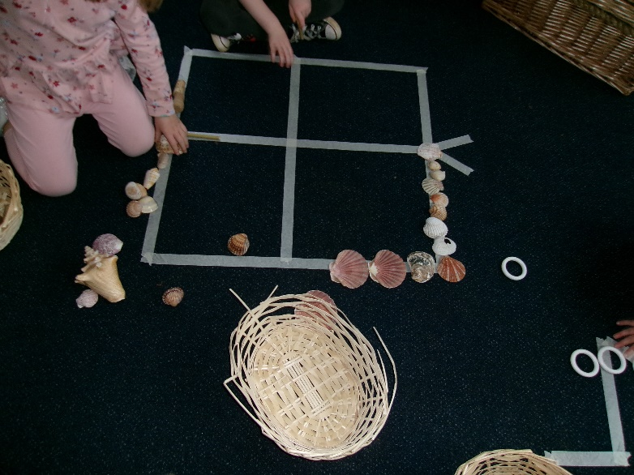
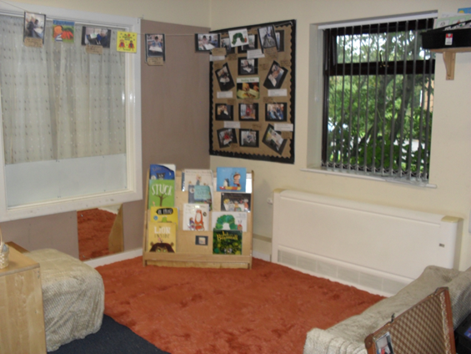
Attendance
Regular attendance at Nursery is known to have a positive impact on children’s learning and progress
We analyse attendance every half term and where this drops to 85% we may get in touch to see if there are any strategies we can give to support with attendance improving.

Slide 8
Key Person
Your child will be linked to a key person. They will be the person that you connect with daily. They will hold meetings with you to discuss your child’s progress.
As a setting we believe that every educator plays a part in your child’s education and as a team we discuss and reflect on every child’s learning journey and next steps.

Slide 9
Communication
Daily a member of staff will be on the gate to welcome your child into nursery and say goodbye to them at the end of the day.
We will send out a link every three weeks that share the key learning focuses in nursery. Stored on the website too.
We will send out a monthly newsletter. Stored on the website too.
Your child’s keyperson will organise a hello call and discuss how your child has settled into nursery, your child will then have a spotlight meetings to discuss their learning journey and next steps will be put together.
Please visit our website which has a great deal of info to share with you. https://www.atherstonenurseryschool.com/
Please do send any photos of your children’s learning experiences and wow moments to admin1000@welearn365.com.

Slide 10
Organisation 15 hours
Children can access 15 hours Nursery Education each week, organised into 5 sessions of 3 hours.
Morning times are: 8.45 – 11.45 am & afternoon times: 12.30 - 3.30pm. Please arrive promptly, to maximise the children’s learning opportunities.
The change between the end of the morning and the afternoon session is very tight. Therefore, we request that you collect your children as promptly as possible and to assist with this, gates will open at 11.35am and 3.20pm. Continual late collection will be charged for as we will have to provide extra staff to care for your child.
From April 2024 – the government have put in place 15 hours funded places for 2-3 year olds for working parents. More info can be found on the following website - https://www.childcarechoices.gov.uk/

Slide 11
Organisation 30 hours
Children can also access 30 hours Nursery Education each week if parent(s) are working and meet the eligibility criteria.
Parents need to access a code from the Gov website and provide the School with the code. This code has to be re-validated every term
This is organised into 5 sessions of 6 hours, with children arriving at 8.45 and being picked up at 2.45 pm. You may purchase an additional 45 minutes and collect at 3.30 pm.
Please arrive promptly so that teaching can start on time and we can maximise the time for children’s learning opportunities
You will have opportunity on the gate when you drop off your child to discuss daily queries.

Slide 12
Independence
Over the coming weeks please can you help your child prepare for nursery through:
Feeding themselves / making choices around healthy snacks
Promoting a toileting routine if your child is ready
Hanging up their own coat
Managing their own clothing and shoes

Slide 13
Early Years Foundation Stage Curriculum
Children follow a planned curriculum through the Early Years Foundation Stage which is a statutory requirement.
3 ‘Prime’ areas of learning are covered which focus on the skills and attitudes children need to learn
4 ‘’Specific’ areas are also covered which focus on the knowledge children need to acquire. The 7 areas of learning are interdependent
Learning is through a play based approach which takes account of children’s interests and starting points. Educators carefully plan building on your child’s prior knowledge and build their skills in each of the curriculum.
We teach children through a focus on Playing and Exploring, Active Learning, Self Motivation, Being Creative and Thinking Critically.
We have high aspirations for all children who attend our Nursery and we would encourage you to work with us to ensure they achieve their potential. This includes attending your child's spotlight meetings, working on next steps alongside us, joining us for family learning workshops throughout the year and encouraging your child to take home a library book weekly.

Slide 14
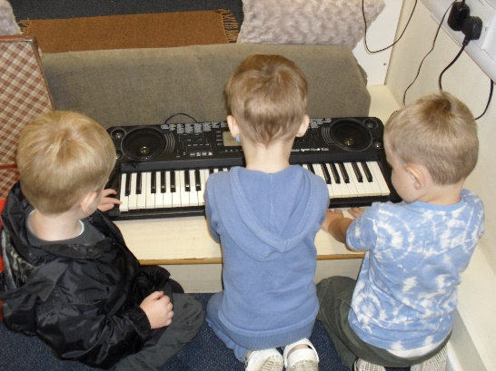
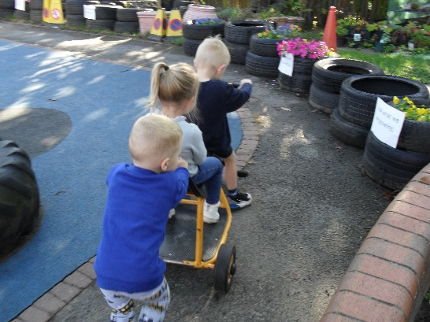
Personal, Social and Emotional Development
Successful personal, social and emotional development is vital for very young children in all aspects of their lives and gives them the best opportunity for success in all other areas of learning. It is crucial that adults provide the experiences and support that young children need to develop a positive view of themselves.
OFSTED Report January 2019:
“Leaders and all staff, are determined to ensure that all children have the best possible experience during their time at the school.
The attractive learning environment is vibrant, and it is organised to promote children’s independence, with plenty of opportunities for investigation and exploration. Adults provide the stimulus and the resources for children to be as creative as possible”.

Slide 15
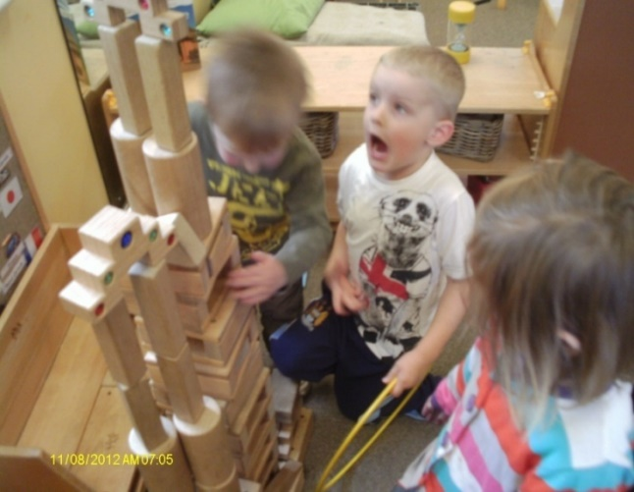
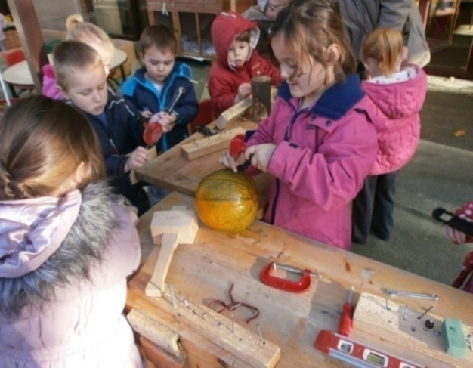
Communication and Language
This area of learning includes:
Speaking & listening in different situations and for different reasons
Learning to pay attention
Developing a wide vocabulary and clear ability to use speech to communicate
Developing a wide understanding of language as we communicate with them and they communicate with each other

Slide 16
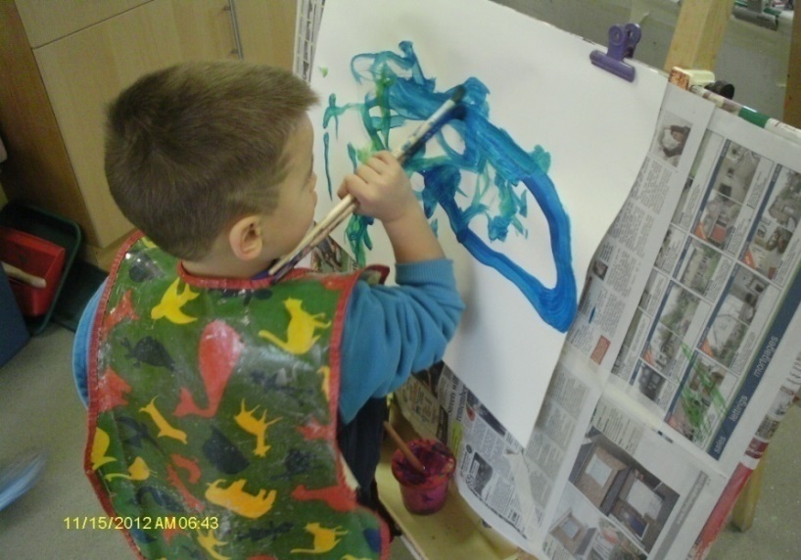
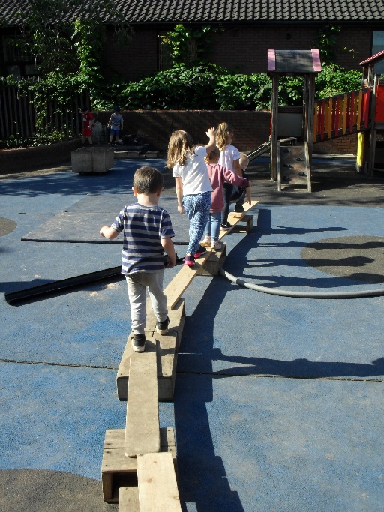
Physical Development
Physical development is about improving skills of co-ordination, control, manipulation and movement
It helps children gain confidence in what they can do and enables them to feel the positive benefits of being healthy & active
We focus on health and self care and the development of good skills in ‘moving, handling and manipulating’ tools and resources

Slide 17
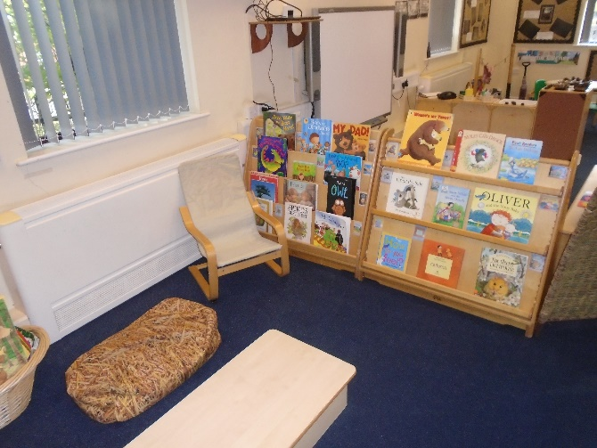
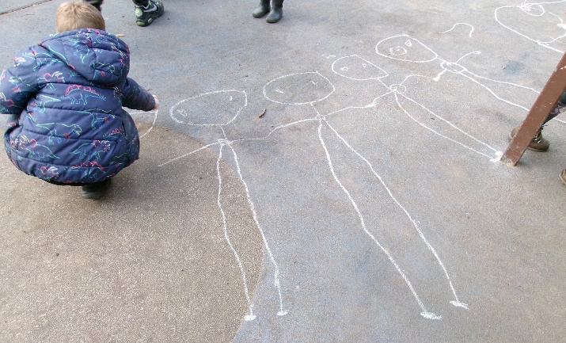
Literacy: Reading & Writing
We aim to develop a love and understanding of books, enjoyment of stories and rhymes and to teach all of the skills needed to be able to read and write
For example, the ability to thread beads onto a string supports the hand eye coordination needed to pick up and manipulate a pencil across a sheet of paper

Slide 18
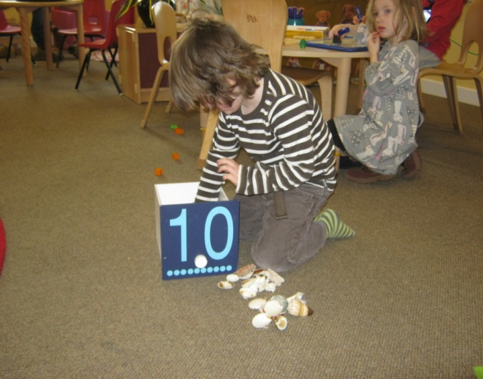
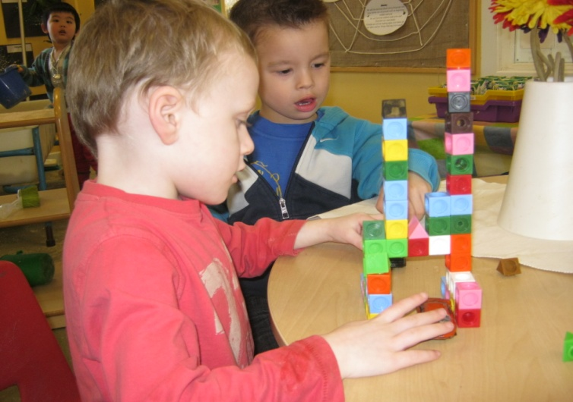
Mathematics
This area of learning includes counting, sorting, matching, seeking patterns, making connections, recognising relationships and working with numbers, shapes & measures.
Mathematical understanding should be developed through stories, songs, games and imaginative play so that children enjoy using and experimenting with numbers, including numbers larger than 10.

Slide 19
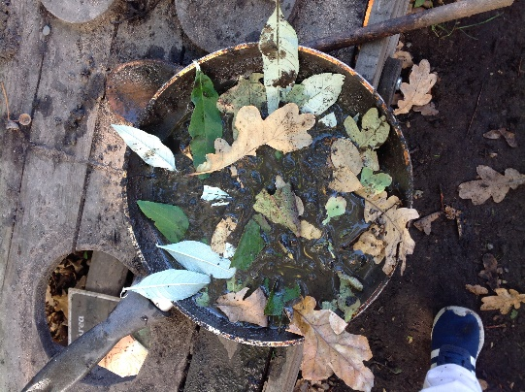
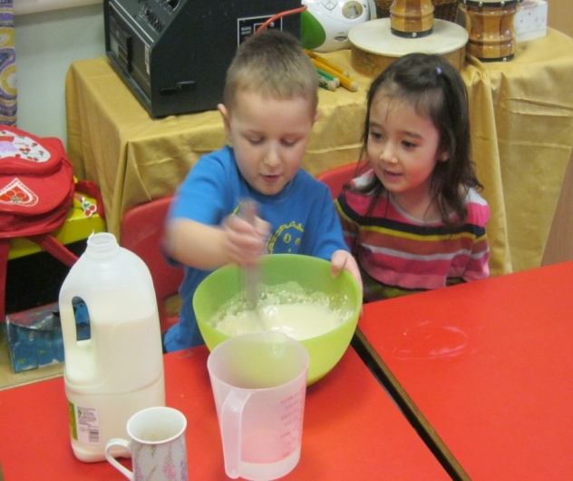
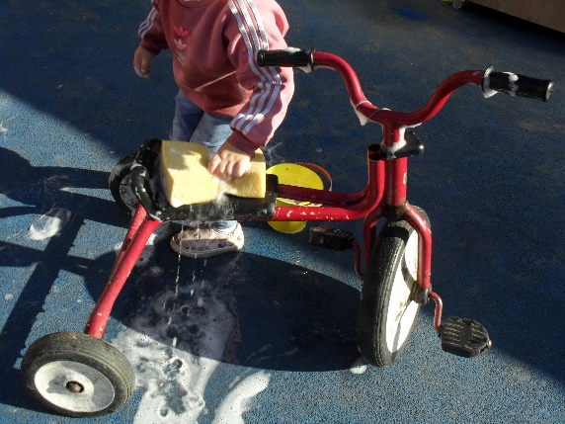
Understanding the World
In this area of learning, children are developing the important knowledge, skills and understanding that help them to make sense of the world.
This forms the foundation for later work in science, design & technology, history, geography within a technologically and ecologically diverse world

Slide 20
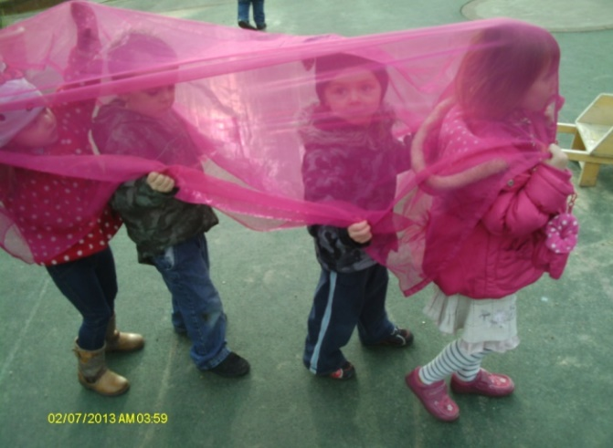
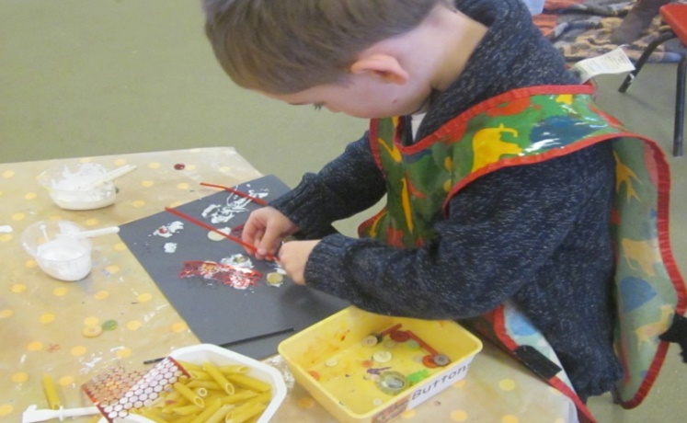
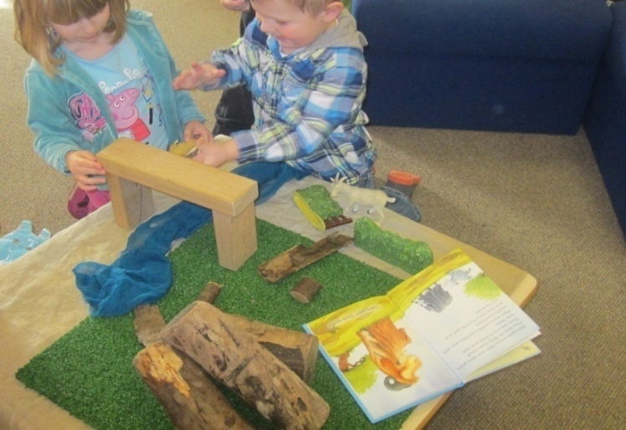
Expressive Arts and Design
This area of learning includes art, music, dance, role-play and imaginative play.
Being creative enables children to make connections between one area of learning and another and so extend their understanding.

Slide 21
OPAL (Observation of Play and Learning)

Slide 23
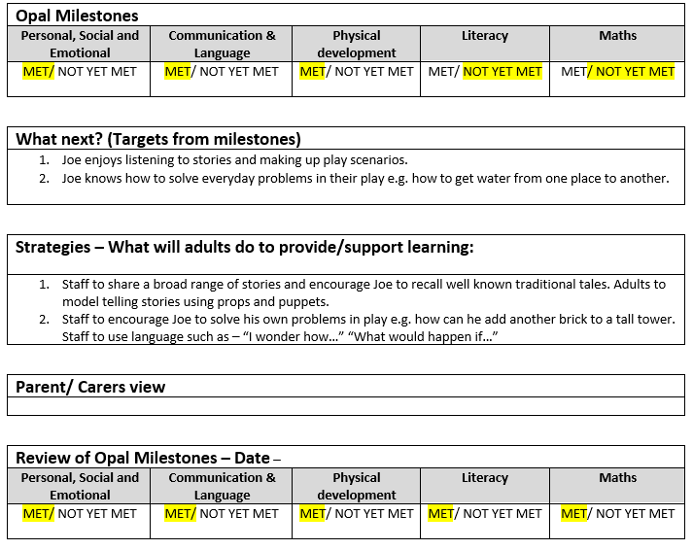

Slide 24
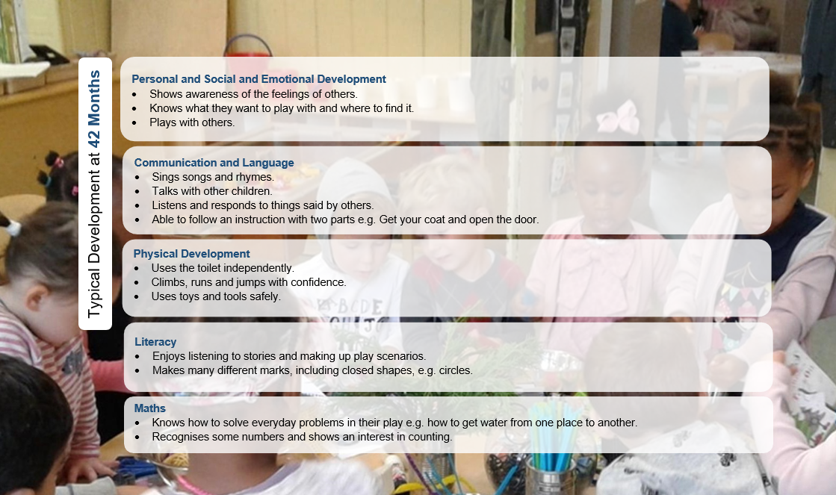

Slide 25
SEND (Special Educational Needs and/or Disability)
Federation SENCO – Sharon Wood
An inclusive Nursery Environment
A sensory Area base
One to one support staff/enhanced ratio
Close working with other professionals – IDS, Physio, SALT
Educational Health and Care Plan pathways

Slide 26
Fundamental Values
In our daily ethos and values we will be promoting the following four statements.
Democracy: making decisions together
Rule of law: understanding rules matter as cited in Personal Social and Emotional development
Individual liberty: freedom for all
Mutual respect and acceptance: treat others as you want to be treated
See the prospectus for further information.

Slide 27
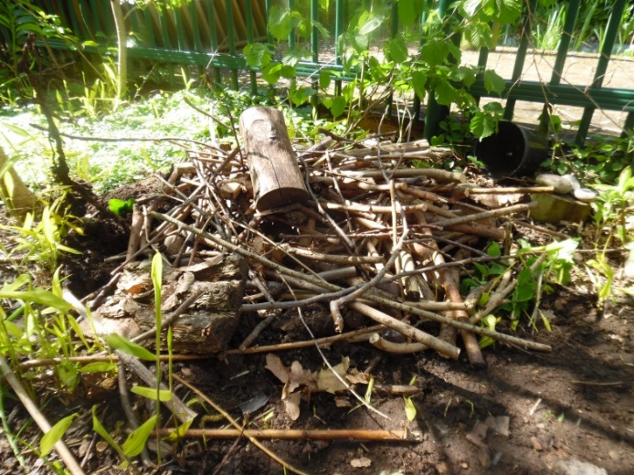
Our Forest and ecosystems at nursery
By participating in engaging, motivating and achievable tasks and activities in a woodland, children have an opportunity to develop intrinsic motivation, sound emotional and social skills.
Our children will have the opportunity to learn about the natural environment, how to handle risks and most importantly to use their own initiative to solve problems and co-operate with others.
We access our forest in all weathers (except for high winds and thunder and lightning storms). Children play, learn boundaries of behaviour; both physical and social, establish and grow in confidence, self-esteem and become self-motivated.
We are looking at our nursery ecosystem and how we can use our forest area to support our children in recognising the importance in looking after the natural world around us.

Slide 28
Nursery Fund
Every family is asked for a voluntary contribution of £1.50 per week, which
can be paid directly into Nursery account.
This is used to fund extension activities e.g. artists and storytellers
It is also used to buy cooking ingredients, bulbs for planting and additional snack that is needed.

Slide 29
Sponsorship

Slide 30
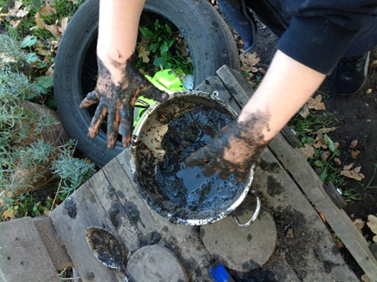
A word of warning!
Children may get messy at Nursery so please send them in old clothes – we support the children in getting to know the materials they are working with – paint, water, mud!
Better still – send them in school sweatshirts and joggers / trousers & school jackets.
Cheap ‘school uniform’ is more economical and washes more easily ‘best’ clothes (see website for purchase information)

Slide 31
Safeguarding
The School has a legal responsibility under Section 175 of the Education Act 2002 to ‘ensure arrangements are in place to safeguard and promote the welfare of children’.
Through their day-to-day contact with children and direct work with families all staff have a crucial role to play in noticing indicators of possible abuse or neglect. staff are trained to deal with this.
Where concerns are raised there is a legal duty to refer these to the appropriate agency, namely Children’s Services.
When requested by such an agency, The School must supply a report with regard to a child’s care, learning and development and attend any subsequent child protection meetings as required.
The School is required to document all cause for concerns and we will discuss these with families’, unless that discussion could place a child at risk of harm

Slide 32
Safety on site
Please ensure the Gate is shut at all times!
Please do not park cars across neighbours driveways or on the yellow zig-zags outside school. Please do not park on the double yellow lines.
No smoking (including E-cigarettes) on site
No dogs on site (except for guide dogs).
Sensible clothing – Autumn / Winter: coat, hat & gloves
Summer: a light coat and sun hat and covered shoulders at all times
Sensible shoes only please ! No flip flops, high heels etc
Ofsted January 2019
Keeping children safe is a high priority and a central part of the school’s work..

Slide 33
Protective Behaviours
​
Protective Behaviours is a framework for personal safety consisting of 2 Themes and 7 Strategies. This is very different from the ‘lock your doors’, restrictive approach to personal safety - it is a dynamic, confidence building, empowering approach that links safety with having adventures and taking risks.
​​
‘We all have the right to feel safe all the time.’
‘We can talk with someone about anything, even if it feels awful or small.’
​
PBs encourages the development of a clear ‘support network’ which we can call upon having identified that we are feeling unsafe. On the support network we would ideally have 5 people who might be able to help us do some problem solving. They might be people who ask questions so that we can come up with our own solutions; they might be people who actually give some advice; they could be friends or family or people at the end of a help line - sometimes it’s easier to ‘phone a help line as they, and us, remain anonymous. It doesn’t necessarily have to be about something that’s really terrible; it might be that we need to mull things over, or celebrate an achievement. Having four people plus the ones at home, is suggested so that we have got a bit of variety and have back up options if our first choice of contact is unavailable.
​
So if we believe we have the right to feel safe and have a support network we then have the opportunity to push the boundaries and take a few risks - not restricting ourselves and staying indoors all the time, but getting out there and having some fun.

Slide 34
Requests From Us
No mobile phones to be used in any teaching and learning spaces, we would like to encourage you to end all calls before coming on site (Staff and families!)
Mind your language – Our children have acute hearing! Please remember to moderate your language on site and around the School
Photographic/video images: Permission must be granted by parents / carers for photos to be taken and used. Images are stored securely. Cameras are owned by the School, not individuals.
Identity badges are issued to staff. All staff and families are encouraged to challenge any visitors to site not displaying an ID badge
A password system is used if the nominated carers are unable to collect

Slide 35
Support for home
We are able to support families with a variety of issues including:
Behaviour
Toilet training
Sleep
Mealtimes
Wider issues such as debt, housing, employment and benefits or Domestic Abuse.
Please speak to Barb who is family link and happy to help.

Slide 36
Routines that will help you and your child:
Try and establish a good bedtime routine- nursery is exhausting for little ones!
Ensure they have had breakfast or lunch before arrival- children will need lots of energy! ( tell us if this has not been possible when you drop off and we can help)
If your child is in a nappy send them in a fresh nappy on arrival, so they can get busy learning straight away.
Toilet train when your child shows they are ready. We will work with you to do the same at nursery.

Slide 37
Please contact us if you have any more questions:
Atherstone Nursery School and Warwickshire Early Years Hub
Kings Avenue
Atherstone
Warwickshire
CV9 1JZ
Tel/Fax: (01827) 794164
Email: admin1000@welearn365.com
Atherstone Nursery School Facebook page
School website: https://www.atherstonenurseryschool.com/

Slide 38
Bedworth Heath Nursery School
We are federated with our sister school Bedworth Heath Nursery School and we collaborate and work in partnership with a shared vision and values.

Slide 39
Any Questions?

